Slide 1
Week-6
COSC 32001 Computer Vision
Noopa Jagadeesh
Date: 15 Feb 2024

Slide 2
Recap
Image Segmentation with Watershed Algorithm
Image Blurring/Smoothing using python
Average blurring
Gaussian Filtering
Median blurring
Bilateral blurring
Morphological transformation
Erosion
Dilation
Opening
Closing
Morphological gradient
Black hat
Top hat (also called “White hat”)
Assignment#1 Student Demo

Slide 3
Agenda
Edge Detection
Contour Detection
Background Subtraction

Slide 4

Critical Path
Students pick presentation topic to be presented in Week#7
Name | Topic
Vyom | Stereo Vision and Depth Estimation
Rhichard | Camera Calibration
Caleb | Pinhole and Perspective Projection
Mohsin | Segmentation using Deep learning
Elise | Color spaces in OpenCV

Slide 5
Student Job Opportunity
Student data analyst who is proficient in Excel, Tableau and PowerApps, and skilled with data cleaning.
The job is posted on the Hired Portal (Career Development - MyAccount - On-campus Employment - On-campus Job Listings (durhamcollege.ca)), job #75927 Data Analyst – Tableau & PowerApps.

Slide 6
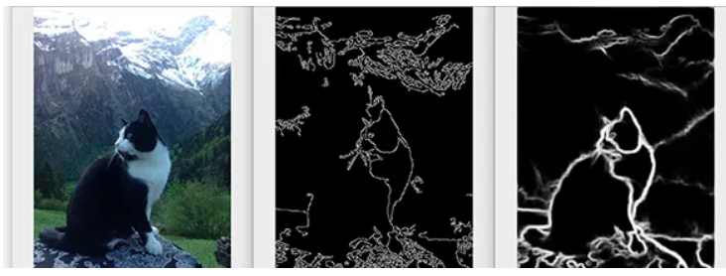
Edge Detection

Slide 7
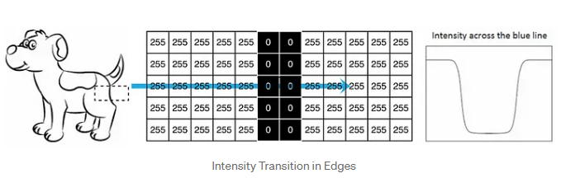
Edge Detection
Simply put, edge detection is a technique used to identify the edges found in an image.
We can define an edge to be a change in pixel or image intensity.
Edges are discontinuities in the intensity, illumination, or depth of an image. They provide more information about an image than any other feature in a digital image. They help determine the shape of an object, identify groups of pixels as objects, and assist in image classification and interactive image editing.
When we move along the direction of the blue line, we can observe a significant change in the intensity of the pixels when we encounter an edge. By comparing the intensity of one pixel to its neighboring pixel, we obtain a graph-like representation on the right side.

Slide 8
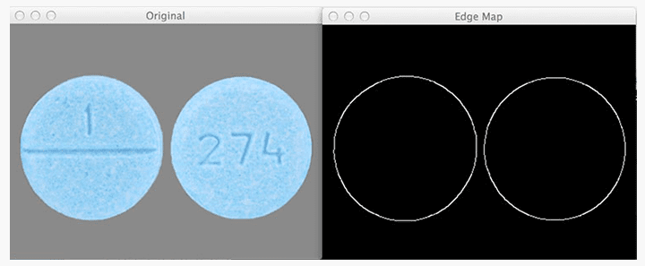
Edge detection
More formally, an edge is defined as discontinuities in pixel intensity, or more simply, a sharp difference and change in pixel values.
On the left, we have our original input image. And on the right, we have the output, or what is commonly called the edge map. Notice how we have only the outlines of the pill as a clear, thin white line — there is no “noise” inside the pills themselves.
Notes:
image gradient

Slide 9

Types of edges in images
Step edge
A step edge forms when there is an abrupt change in pixel intensity from one side of the discontinuity to the other.
As the name suggests, the graph actually looks like a step — there is a sharp 90⁰ step in the graph, indicating an abrupt change in pixel value. These types of edges tend to be easy to detect.

Slide 10

Types of edges in images
Ramp edge
A ramp edge is like a step edge, only the change in pixel intensity is not instantaneous. Instead, the change in pixel value occurs a short, but finite distance.
Here, we can see an edge that is slowly “ramping” up in change, but the change in intensity is not immediate like in a step edge.

Slide 11
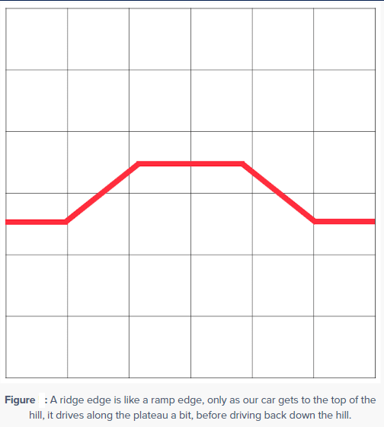
Types of edges in images
Ridge edge
A ridge edge is similar to combining two ramp edges, one bumped right against another. It is like driving up and down a large hill or mountain.
In the context of edge detection, a ramp edge occurs when image intensity abruptly changes, but then returns to the initial value after a short distance.

Slide 12
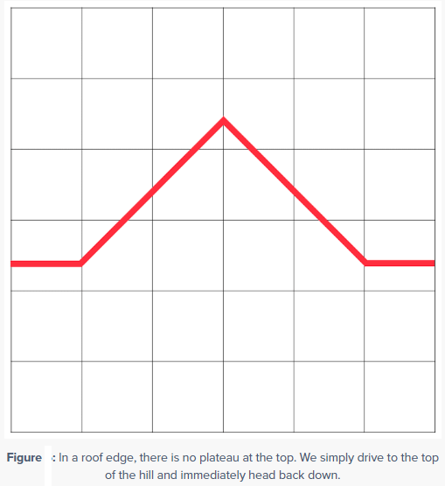
Types of edges in images
Roof edge
It is a type of ridge edge.
Unlike the ridge edge where there is a short, finite plateau at the top of the edge, the roof edge has no such plateau. Instead, we slowly ramp up on either side of the edge, but the very top is a pinnacle and we simply fall back down the bottom.

Slide 13
OpenCV Edge Detection
Edge detection is an image-processing technique that is used to identify the boundaries (edges) of objects or regions within an image.
Edges are among the most important features associated with images. We know the underlying structure of an image through its edges. Computer vision processing pipelines, therefore, extensively use edge detection in applications.
Sudden changes in pixel intensity characterize edges. We need to look for such changes in the neighboring pixels to detect edges. The two important edge-detection algorithms available in OpenCV: Sobel Edge Detection, Laplacian Edge Detection and Canny Edge Detection.

Slide 14
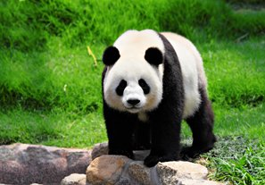
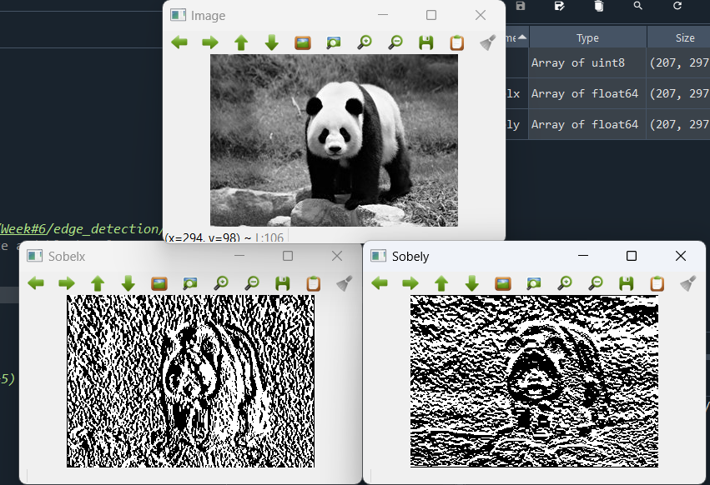
Edge detection Code
There is lot of noise.
How can we do better?
How can we do better? Blurring.
However, we will loose details.
Sobel Edge Detection

Slide 15
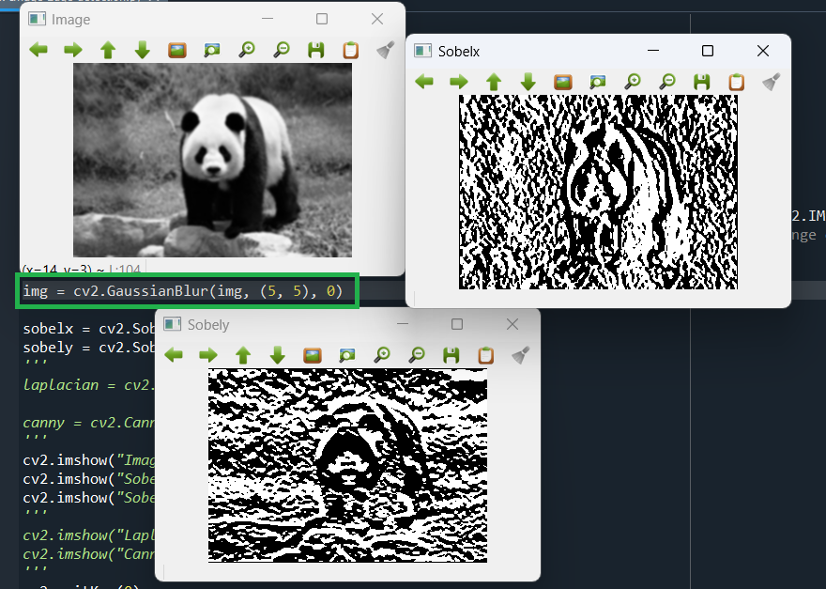
Edge detection Code

Slide 16
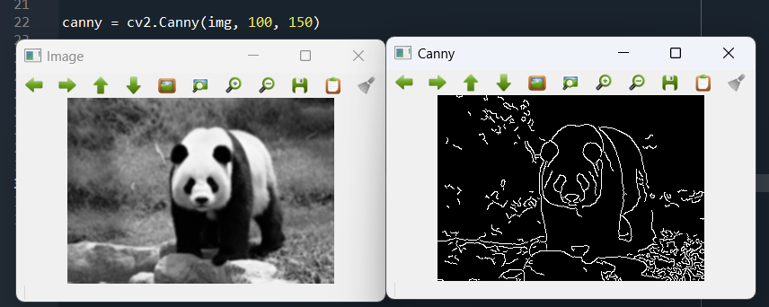

Edge detection Code
https://docs.opencv.org/3.4/da/d22/tutorial_py_canny.html
We supply the two thresholds used by the Canny Edge Detection algorithm, and OpenCV handles all the implementation details. Here, I am saying values below 100 are sure to be non-edges and values higher than 150 are sure to be edges. And the values in-between 100 and 150 can be edges or not. For this the algorithm will try to figure out if it is edges or not.
Don’t forget to blur the image before calling the Canny() function. It is a highly-recommended preprocessing step.

Slide 17
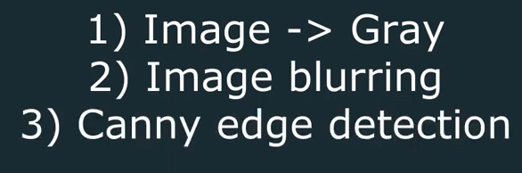
Real Time Edge detection Code

Slide 18
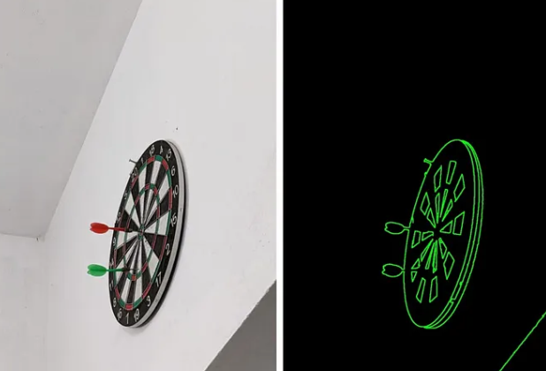
Contour Detection

Slide 19
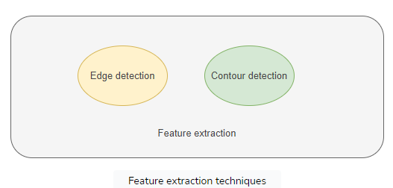
Contour Detection
Contouring is a fundamental technique in computer vision and image processing, playing a crucial role in identifying and extracting object boundaries within an image.
Contours, represented as continuous lines or curves, define the complete boundary of an object.
Two main techniques used in computer vision for feature extraction are edge detection and contour detection
Feature extraction is a process in computer vision that we use to simplify complex visual data, like images, into some basic patterns or features. The machines can recognize important information, helping in tasks like image recognition or object detection.

Slide 20
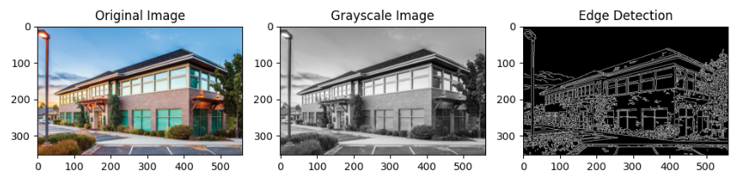
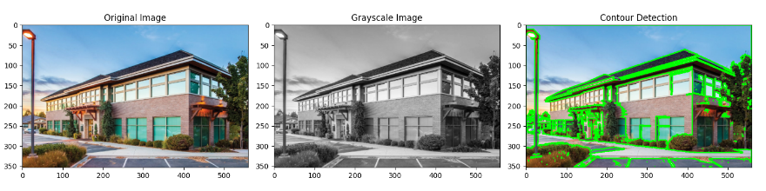
Contour Detection
Edge detection is a technique used to identify the edges found in an image. We can define an edge to be a change in pixel or image intensity.
Contour detection is a technique used in computer vision that can identify and extract the boundaries of objects in an image. Contours are curves joining all continuous points along the boundary having the same color or intensity.

Slide 21
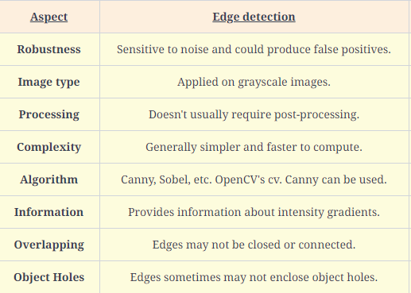
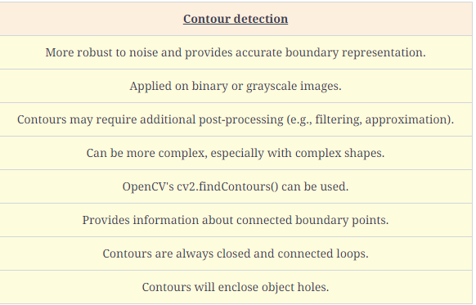
Contour Detection

Slide 22
Contour Detection in OpenCV
OpenCV, a powerful open-source computer vision library, offers the cv2.findContours() function for contour detection.
It’s essential to have a black background and white foreground for proper functioning of findContours(). If this condition is not met, the cv2.bitwise_not() function can be used to invert the image.
Steps in Contouring
Grayscale Conversion: Simplify contour detection by converting the image to grayscale.
Binarization: Create a binary image through thresholding or Canny edge detection.
Contour Detection: Utilize cv2.findContours() to find contours in the binary image.
Draw Contours: Visualize the detected contours on the original image.

Slide 23
Contour Detection in OpenCV
Retrieval Modes
OpenCV provides four retrieval modes:
RETR_LIST: Retrieve all contours without establishing a parent-child relationship.
RETR_EXTERNAL: Return only the extreme outer contours, omitting child contours.
RETR_CCOMP: Organize contours into a 2-level hierarchy, differentiating external and internal contours.
RETR_TREE: Retrieve all contours and create a full family hierarchy list.
Approximation Methods
Two approximation methods are available:
CHAIN_APPROX_NONE: Store all points along the line, providing accurate but potentially inefficient representation.
CHAIN_APPROX_SIMPLE: Store only the end points of each line, offering a more efficient representation.

Slide 24
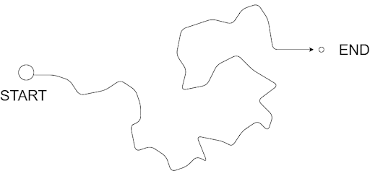
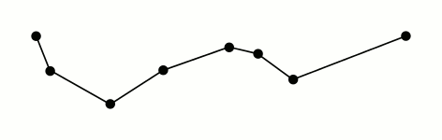
Contour Approximation
Contour approximation, which uses the Ramer–Douglas–Peucker (RDP) algorithm, aims to simplify a polyline by reducing its vertices given a threshold value. In layman terms, we take a curve and reduce its number of vertices while retaining the bulk of its shape.

Slide 25
Background Subtraction

Slide 26
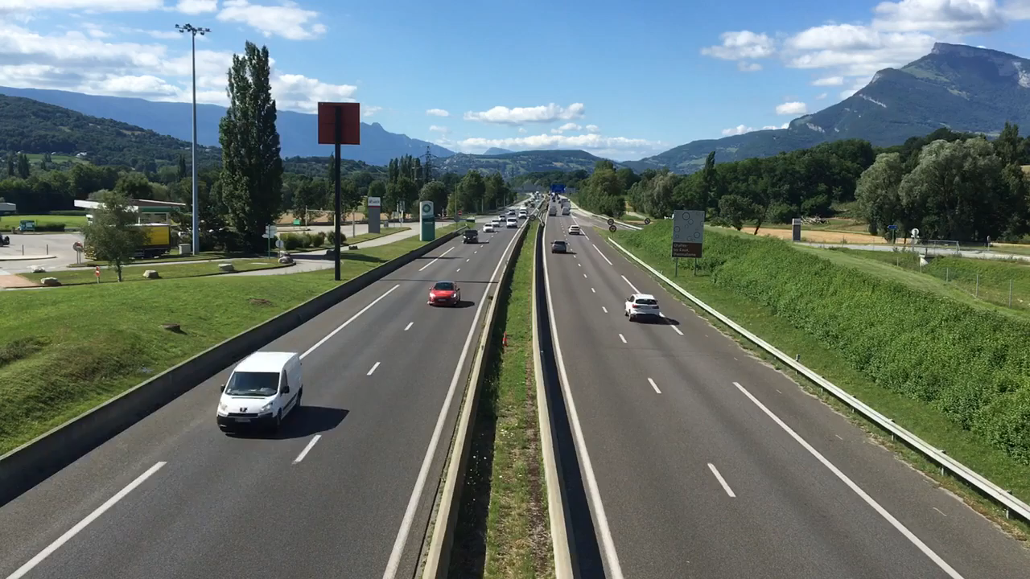
Background Subtraction

Slide 27
Disclaimer
Due to nature of the course, various materials have compiled from different open source resources with some moderation. I sincerely acknowledge their hard work and contribution

Slide 28


